Slide 1
Inaugural
“JTLS-GO Operational Lifecycle Practicum”
Program Overview
Ukraine NDU JTLS-GO Training Program:
A new benchmark for high-fidelity operational training.
Vance Southern
JTLS-GO Support Manager
VALKYRIE ENTERPRISES
Notes:
Slide 1: Title Slide – The Inaugural JTLS-GO Operational Lifecycle Practicum
Time: 2 Minutes Script: "Good morning, colleagues and fellow JTLS-GO practitioners. My name is Vance Southern. Today, I’m briefing you on a significant milestone in our international training portfolio: the Ukraine NDU Training Program.
We’ve officially designated this as the 'Operational Lifecycle Practicum.' It represents a fundamental shift from traditional software instruction to a full-spectrum capability build. We didn't just teach a class; we helped a partner build a national simulation capability from a blank database all the way to staff-level operational analysis."

Slide 2




The 6-Week Curriculum Roadmap (Virtual)
Database & System Tools (DDS)
Scenario Development/Game Dynamics
Weeks 1-3: Mastering the DDS Interface.
Construction of custom TUPs, SUPs, and HUPs
Side/Faction logic and diplomatic relations
New Combat Systems and Platforms
Complete Order of Battle
Terrain Generation
Weeks 4-5: Engineering advanced Scenarios.
Focused Vinettes
Multi-Domain Operations
Shaping Theater Specific Environments
Joint/Coalition Coordination
Civilian/Military Interactions
Analysis & Operational Planning
The Outcome
Weeks 6: "Operationalizing" the database. Capstone execution of staff-planned operation and comprehensive analysis of results. Final delivery of the master Ukraine64 database files.
Transition from software trainees to lead practitioners capable of independent national defense wargaming and decision support.
2 Week In-Person Technical Seminar for select staff
Notes:
Slide 2: The 6-Week Curriculum Roadmap (Virtual & In-Person)
Time: 6 Minutes Script: "This was a marathon, not a sprint. We broke the 6-week curriculum into three major blocks delivered virtually, followed by an intensive in-person seminar.
In Weeks 1 through 3, we lived in the DDS. The focus was on the 'ingredients'—customizing TUPs, SUPs, and HUPs to reflect the current reality of their theater. They didn't just learn the interface; they built their entire national Order of Battle.
Weeks 4 and 5 moved into Scenario Engineering. We moved away from generic playboxes and into focused vignettes. We looked at multi-domain operations and theater-specific environments, including the complex civilian and military interactions unique to their current situation.
Finally, in Week 6, we 'Operationalized' the data. This was the capstone where the staff executed their own planned operations, culminating in the handoff of the validated Ukraine64 master files. The outcome was clear: they transitioned from trainees to practitioners capable of independent national defense wargaming."

Slide 3
The Power of the Practicum:
Moving beyond instruction to immersion and ownership.
Hands-On Practical Application
Active Build Model: Trainees construct their actual theater environment, not a generic training playbox.
Troubleshooting Proficiency: Building from scratch allows users to identify and resolve execution errors independently.
Operational Ownership: The final AAR focuses on the student-built Ukraine64 scenario, fostering long-term system sustainability.
Notes:
Slide 3: The Power of the Practicum: Immersion and Ownership
Time: 5 Minutes Script: "Why did this work so well? It comes down to ownership. In a traditional course, we provide the scenario. In this Practicum, the trainees built their own.
This 'Active Build Model' meant that when an error occurred in execution, the trainees knew exactly where to look in the database to fix it. This created a level of troubleshooting proficiency we rarely see in standard courses. By the time we reached the final AAR, the students weren't just participating in a game—they were defending a scenario they had engineered from the ground up. This approach ensures long-term system sustainability once our team leaves the room."

Slide 4
Practicum vs. Traditional Training
Training Feature | Standard Course | Operational Practicum
Primary Focus | Interface Familiarization | Operational Capability
Content Basis | Generic Exercise Scenarios | High-Fidelity National ORBAT
Technical Depth | Surface Level | Full Lifecycle Engineering
Final Outcome | Certificate of Attendance | Master Database Handoff
Partner Autonomy | Limited Troubleshooting | Independent National Reach
Notes:
Slide 4: Practicum vs. Traditional Training
Time: 4 Minutes Script: "If we look at the comparison on this slide, the differences are stark. Standard courses often stop at interface familiarization. We pushed for Operational Capability.
Instead of generic exercises, we used a High-Fidelity National ORBAT. This allowed the attendees to see the immediate value of the simulation for their day-to-day planning. The final outcome wasn't just a certificate of attendance—it was a master database handoff that was ready for immediate use by their General Staff. We empowered them with 'Independent National Reach,' meaning they can now troubleshoot and evolve their scenarios without needing to wait for a technical reach-back."

Slide 5
Theater-Specific Insights
Trench Warfare: Custom modeling of entrenchments and obstacles based on 2026 battlefield realities.
Rail-Centric Logistics: Accurately representing the unique supply trans-shipment points in Eastern Europe.
UAS Swarms: Evaluating future capabilities and loitering munitions within the JTLS-GO environment.
Battlefield Support: Unique requirements for recovery equipment, cover & concealment, specialized units
Notes:
Slide 5: Theater-Specific Insights & The Complexity Curve
Time: 8 Minutes Script: "This is where the training got truly innovative. Because we had over 40 virtual attendees who were seasoned professionals, they pushed the system into new and unexpected ways.
As they became more comfortable with the environment, their questions moved from 'how-to' to high-level 'decision science.' They began to identify potential risks and critical decision points within the simulation. This pushed us to home in on specific requirements that aren't usually the focus of a standard build.
For example, we spent significant time on Logistics and Attritional Modeling. We looked at Maintenance and Equipment Recovery operations—modeling how a damaged platform moves from the front to a repair shop and back. We explored Self-Defense capabilities, focusing on cover and concealment for non-combatant units. They also utilized High-Resolution Units (HRUs) to get the granular data needed for senior planners. They weren't just learning JTLS-GO; they were using it to solve the most complex problems of modern warfare."

Slide 6
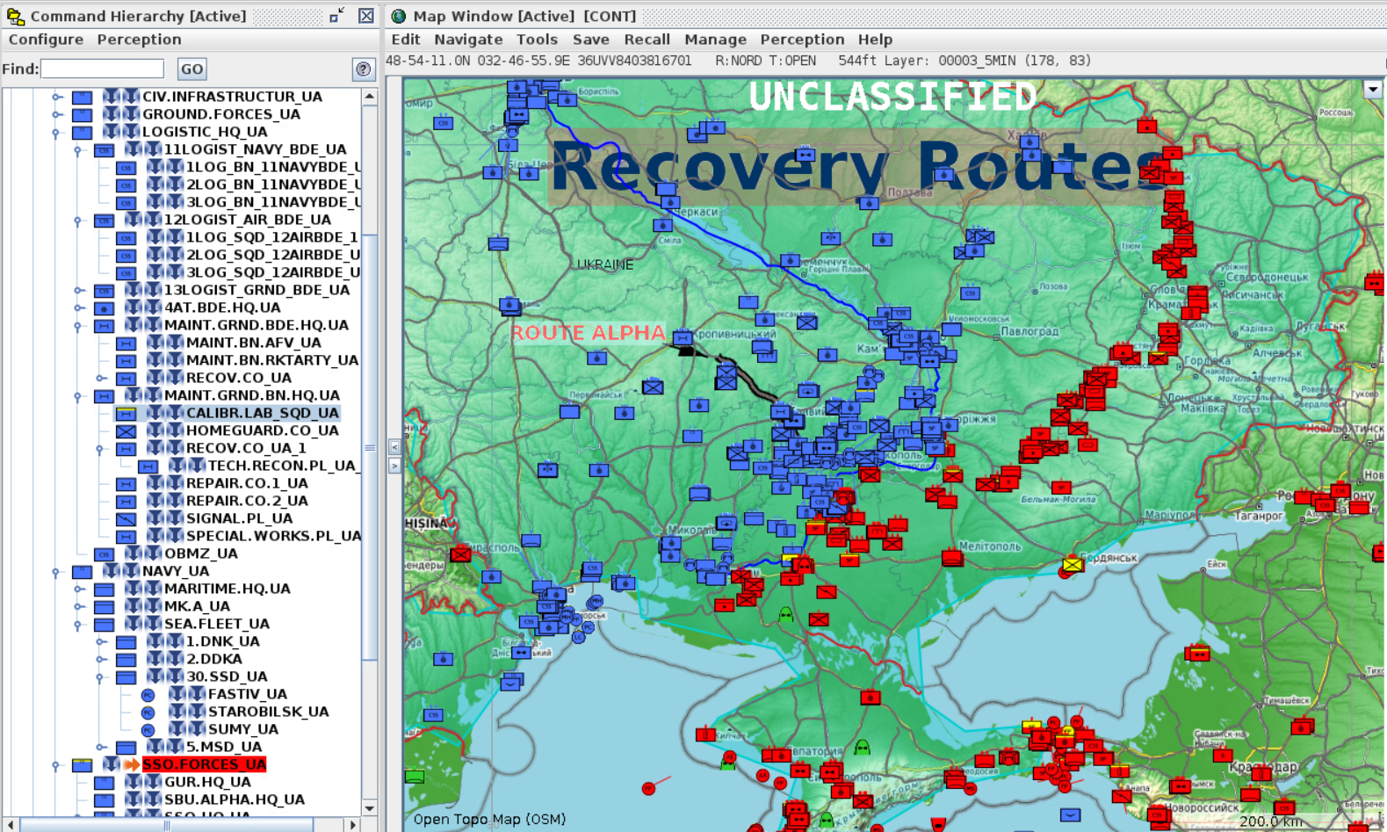
Notes:
Slide 5: Theater-Specific Insights & The Complexity Curve
Time: 8 Minutes Script: "This is where the training got truly innovative. Because we had over 40 virtual attendees who were seasoned professionals, they pushed the system into new and unexpected ways.
As they became more comfortable with the environment, their questions moved from 'how-to' to high-level 'decision science.' They began to identify potential risks and critical decision points within the simulation. This pushed us to home in on specific requirements that aren't usually the focus of a standard build.
For example, we spent significant time on Logistics and Attritional Modeling. We looked at Maintenance and Equipment Recovery operations—modeling how a damaged platform moves from the front to a repair shop and back. We explored Self-Defense capabilities, focusing on cover and concealment for non-combatant units. They also utilized High-Resolution Units (HRUs) to get the granular data needed for senior planners. They weren't just learning JTLS-GO; they were using it to solve the most complex problems of modern warfare."

Slide 7

Conclusion & Discussion
Special thanks to Colonel Sova and the graduates of the Operational Lifecycle Practicum.
Contact Information:
Vance Southern
JTLS-GO Training & Support Manager
Email: james.southern@valkyrie.com
Notes:
Slide 5: Theater-Specific Insights & The Complexity Curve
Time: 8 Minutes Script: "This is where the training got truly innovative. Because we had over 40 virtual attendees who were seasoned professionals, they pushed the system into new and unexpected ways.
As they became more comfortable with the environment, their questions moved from 'how-to' to high-level 'decision science.' They began to identify potential risks and critical decision points within the simulation. This pushed us to home in on specific requirements that aren't usually the focus of a standard build.
For example, we spent significant time on Logistics and Attritional Modeling. We looked at Maintenance and Equipment Recovery operations—modeling how a damaged platform moves from the front to a repair shop and back. We explored Self-Defense capabilities, focusing on cover and concealment for non-combatant units. They also utilized High-Resolution Units (HRUs) to get the granular data needed for senior planners. They weren't just learning JTLS-GO; they were using it to solve the most complex problems of modern warfare."

